Slide 1




Bilgisayar Mühendisliği Bölümü
GTU CSE 496
GRADUATION PROJECT -2-
TURKISH TEXT CORRECTOR PLUGIN
ÇAĞRI ÇAYCI
ADVISOR: Dr. GÖKHAN KAYA
JUNE 2024
GTÜ - Bilgisayar Mühendisliği Bölümü
BİL 495/496 Bitirme Projesi
GTU COMPUTER ENGINEERING DEPARTMENT
CSE 496 GRADUATION PROJECT 2
Notes:
2

Slide 2

Contents
Review
Design Plan
Completed Tasks
Final Product
Timeline
Success Criteria
Resources
GTU COMPUTER ENGINEERING DEPARTMENT
CSE 496 GRADUATION PROJECT 2
Notes:
2

Slide 3
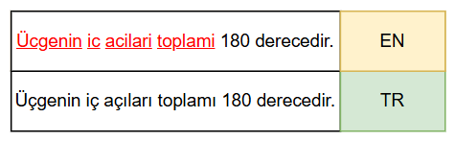
Review
Turkish Text Corrector Plugin is a browser extension intended to correct errors that arise when users type Turkish words using an English keyboard layout. This tool boosts typing accuracy and speed, especially for users who often need to type Turkish text but face limitations due to keyboard layout constraints.
GTU COMPUTER ENGINEERING DEPARTMENT
CSE 496 GRADUATION PROJECT 2
GTÜ - Bilgisayar Mühendisliği Bölümü
BİL 495/496 Bitirme Projesi

Slide 4
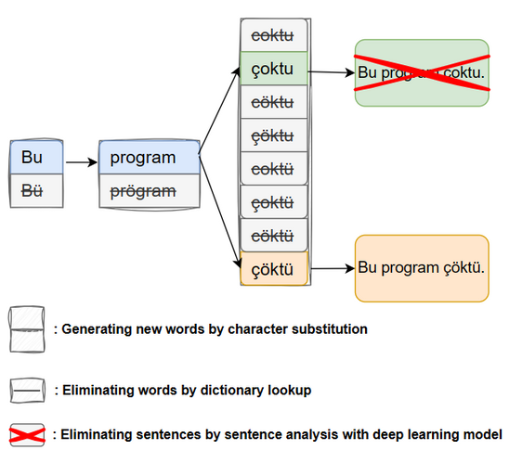
Design Plan
This project consists of 3 main steps:
Character Substitution: Substituting 'c' with 'ç', 'g' with 'ğ', 'i' with 'ı', etc.
Dictionary Lookup: Verifying words against a Turkish dictionary.
Proper Sentence Analysis: Composing the sentences using the most proper words and selecting most proper sentence.
GTU COMPUTER ENGINEERING DEPARTMENT
CSE 496 GRADUATION PROJECT 2
GTÜ - Bilgisayar Mühendisliği Bölümü
BİL 495/496 Bitirme Projesi

Slide 5
Completed Tasks
What things have been done previously;
A vocabulary dataset has been collected.
An extension capable of generating new words by character substitution and eliminating by dictionary lookup have been created.
A large dataset of sentences is gathered and cleaned.
Several deep learning models have been developed and tested, but they have failed.
GTU COMPUTER ENGINEERING DEPARTMENT
CSE 496 GRADUATION PROJECT 2
GTÜ - Bilgisayar Mühendisliği Bölümü
BİL 495/496 Bitirme Projesi

Slide 6
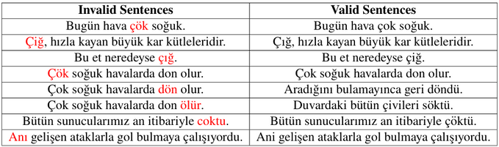
Completed Tasks
What things have been done so far;
1. Synthetic Sentences: Previously, dataset contains only valid sentences and to avoid overfitting for binary classification synthetic invalid sentences have been created.
2. Deep Learning Model Development: A deep learning model has been developed as a binary classifier.
GTU COMPUTER ENGINEERING DEPARTMENT
CSE 496 GRADUATION PROJECT 2
GTÜ - Bilgisayar Mühendisliği Bölümü
BİL 495/496 Bitirme Projesi

Slide 7
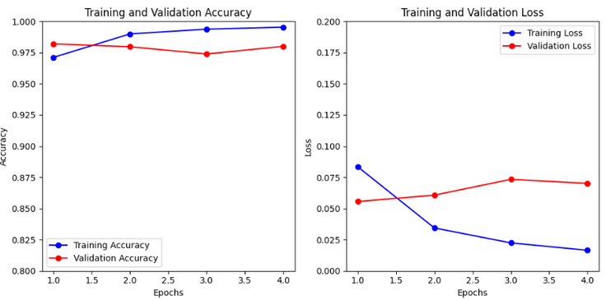
Completed Tasks
3. Deep Learning Model Training: Deep Learning Model has been trained with 3 millions of valid and 3 millions of invalid sentences.
GTU COMPUTER ENGINEERING DEPARTMENT
CSE 496 GRADUATION PROJECT 2
GTÜ - Bilgisayar Mühendisliği Bölümü
BİL 495/496 Bitirme Projesi

Slide 8

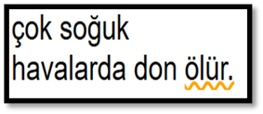
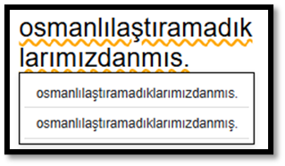
Completed Tasks
4. Integration of the System: All functionalities have been combined and integrated to the web plugin.
5. Graphical User Interface: A simple UI has been designed to show uncertainty of the deep learning model for a word.
6. Vowel Harmony: Major and minor vowel harmony have been incorporated to eliminate words that are not found in the dictionary.
GTU COMPUTER ENGINEERING DEPARTMENT
CSE 496 GRADUATION PROJECT 2
GTÜ - Bilgisayar Mühendisliği Bölümü
BİL 495/496 Bitirme Projesi

Slide 9
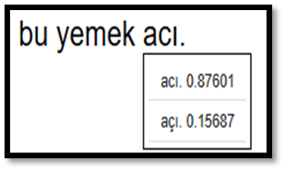
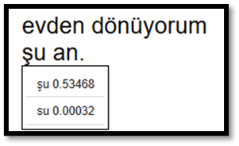
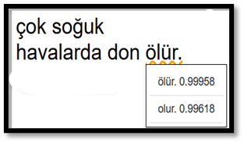
Final Product
Project’s Strength
The deep learning model exhibits high confidence when selecting the correct words but demonstrates significantly lower confidence when choosing incorrect ones.
GTU COMPUTER ENGINEERING DEPARTMENT
CSE 496 GRADUATION PROJECT 2
GTÜ - Bilgisayar Mühendisliği Bölümü
BİL 495/496 Bitirme Projesi

Slide 10
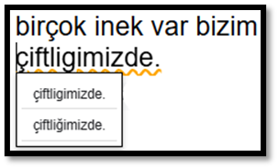
Final Product
Project’s Weakness
Due to its agglutinative nature, the Turkish language has the capacity to generate an infinite array of words. Consequently, while vowel harmony facilitates the coverage of more words within a given dataset, a substantial portion of the vocabulary remains unaccounted for.
GTU COMPUTER ENGINEERING DEPARTMENT
CSE 496 GRADUATION PROJECT 2
GTÜ - Bilgisayar Mühendisliği Bölümü
BİL 495/496 Bitirme Projesi

Slide 11
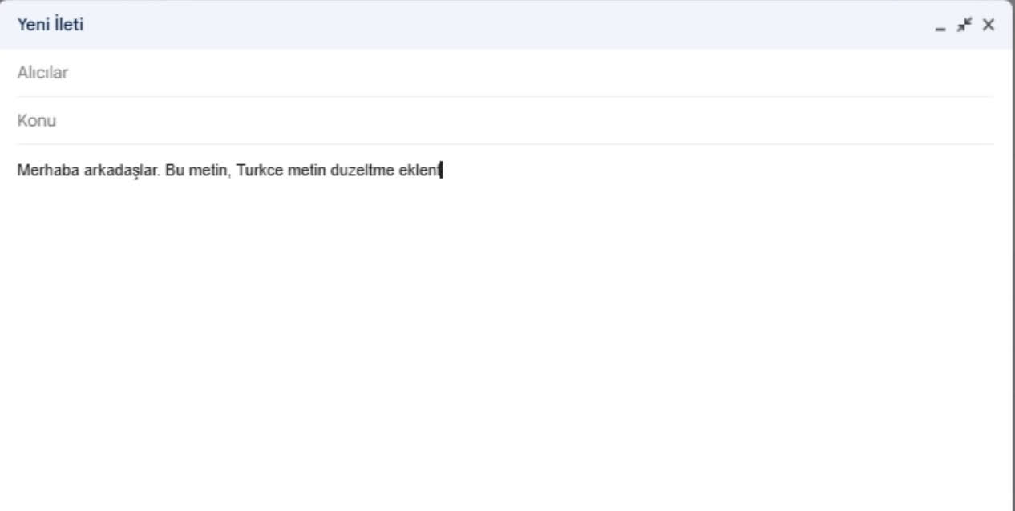
Final Product
GTU COMPUTER ENGINEERING DEPARTMENT
CSE 496 GRADUATION PROJECT 2
GTÜ - Bilgisayar Mühendisliği Bölümü
BİL 495/496 Bitirme Projesi

Slide 12
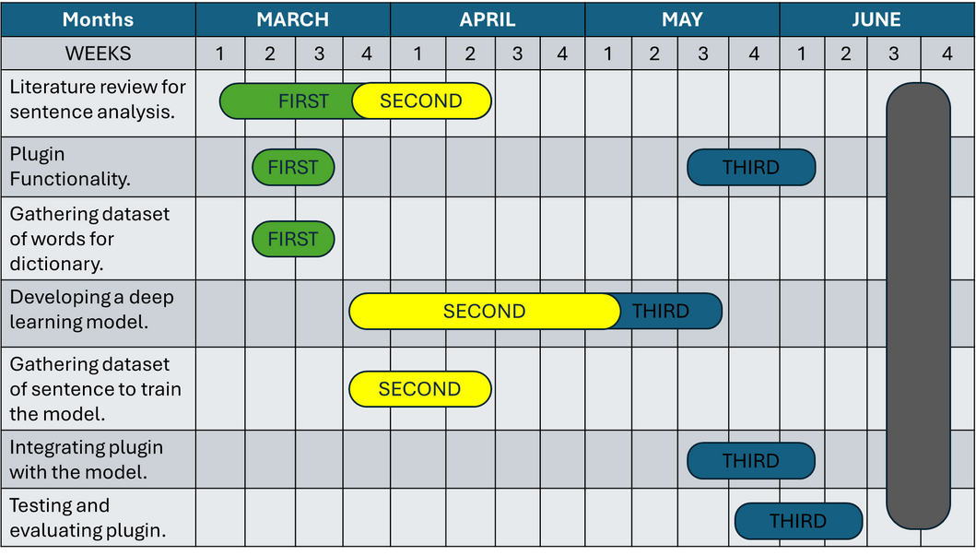
Timeline
The project has reached its current stage exactly as planned on the timeline.
GTU COMPUTER ENGINEERING DEPARTMENT
CSE 496 GRADUATION PROJECT 2
GTÜ - Bilgisayar Mühendisliği Bölümü
BİL 495/496 Bitirme Projesi

Slide 13
Success Criteria
Success criteria for the Turkish Text Corrector Plugin are;
Trivial Words Correction: Achieve a success rate of 100% for correcting trivial words which are in corpus.
Non-Trivial Words Correction: Achieve a success rate of 60% or higher in accurately correcting non-trivial words, which encompass words that may consist of multiple words or are absent from the corpus.
Timeliness: Find the incorrect words and make the necessary corrections within 3 seconds after the completion of the sentence.
GTU COMPUTER ENGINEERING DEPARTMENT
CSE 496 GRADUATION PROJECT 2
GTÜ - Bilgisayar Mühendisliği Bölümü
BİL 495/496 Bitirme Projesi

Slide 14
Success Criteria
The plugin corrects the words which have only one variation in the dataset with 100% success rate.
The plugin tested with 1000 words which have no variation or multiple variations in the dataset and it corrects the words with 90% success rate. 60% of errors are model-related, 40% of them are dataset-related.
The plugin corrects the word within 5 seconds initially; however, over time, it converges to 4 seconds.
GTU COMPUTER ENGINEERING DEPARTMENT
CSE 496 GRADUATION PROJECT 2
GTÜ - Bilgisayar Mühendisliği Bölümü
BİL 495/496 Bitirme Projesi

Slide 15
Resources
https://matplotlib.org/
https://colab.research.google.com/
https://www.drawio.com/
https://clipchamp.com/en/
GTU COMPUTER ENGINEERING DEPARTMENT
CSE 496 GRADUATION PROJECT 2
GTÜ - Bilgisayar Mühendisliği Bölümü
BİL 495/496 Bitirme Projesi

Slide 16
THANK YOU FOR LISTENING
GTU COMPUTER ENGINEERING DEPARTMENT
CSE 496 GRADUATION PROJECT 2
GTÜ - Bilgisayar Mühendisliği Bölümü
BİL 495/496 Bitirme Projesi

